Slide 1
Graph Database (Neo4j)

Slide 2
Installation
Install Desktop app , need JDK to be installed first.
Go to Neo4j Download Center - Neo4j Graph Data Platform
Download neo4j.exe ( current version not work with add database so I do uninstall then install previous version which is work correctly)
Copy Activation Key
Run neo4j.exe Installer
Open neo4j you will see project which can contain one or more graph database ( only one active at a time)
Add local graph db which is empty then go to plugin and install APROC
Which refer to cypher procedure will be need to import file contain data.

Slide 3
Installation
Click manage in database then write this line in setting apoc.import.file.enabled=true
Then select folder and choose drwho.grahml file
Then click start in db and select browser
CALL apoc.import.grahml('drwho.graphml',{batchSize:10000,StoreNodeIds:false,ReadLabels:true})
Or you can execute command :play movie-graph to import movie demo if you can not obtain drwho graph database

Slide 4
Browsing Database
You will see total overall number of nodes and total number grouped by label also you will see the node caption which is choose from node property.
The type of information you need from db must be always in your mind and reflect on your design so if you need info. related to date you can add nodes for year and other for month, this is consider as normalization and may take more time in processing but it consider nothing if compare with RDB. It is always better and more flexible to go to low granularity level.

Slide 5
What is Cypher?
Cypher is Neo4j's graph query language that lets you retrieve data from the graph. It is like SQL for graphs, and was inspired by SQL so it lets you focus on what data you want out of the graph.
Cypher is Declarative so all you should known is what you want to retrieve not how neo4j will retrieve it.
Cypher used clauses (where clause ,order by clause and union) like sql.
Cypher based on pattern matching ( partial graph or can say a snapshot in your mind) then match with others.

Slide 6
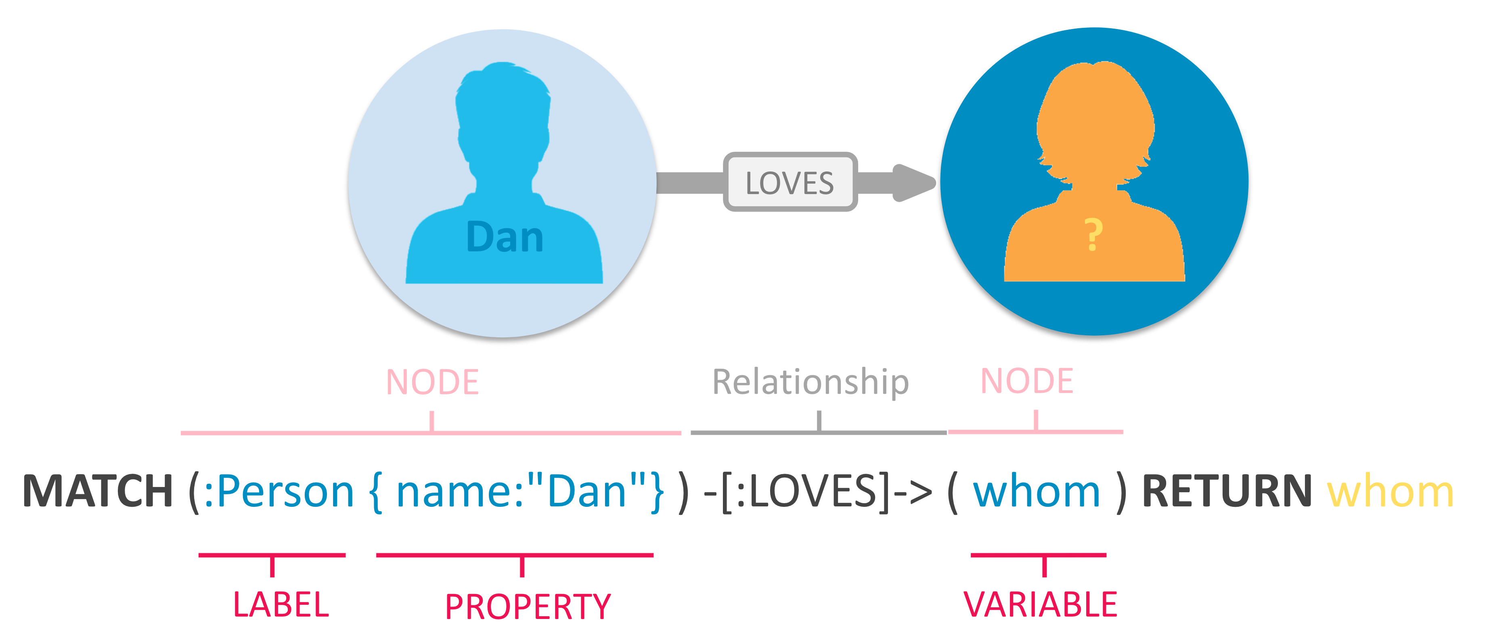
What is Cypher?
Patter example:

Slide 7
What is Cypher?
Where clause is as SQL it filter resultset
Example :
Match(a:Actor)-[:Played]->(c:character)
Where a.name=‘MATT’
Return C
Order by c.name
Limit 10
Skip 5
We can match pattern with anonymous relation or node or direction.

Slide 8
What is Cypher?
Manipulate Data:
CREATE(n): n can be node or whole pattern or variable return from MATCH function.
DELETE(n) : n can be node or whole pattern or variable return from MATCH function.
SET : used to update value of node return from MATCH Function, if property not exists then create it else update it. Set is also can used to update label.
REMOVE():remove property or label , it is like assign NULL.
MERGE: like MATCH but if condition not exist then create it.
FOREACH: is used to update data within a collection ( can be on all nodes in the match (variable in both side of relation )

Slide 9
What is Cypher?
CREATE INDEX ON :NODELABEL(PROPERTYNAME)
CREATE CONSTRAINT ON (a: NODELABEL) ASSERT a:PROPERTY is UNIQUE.
Import CSV FILES easily.

Slide 10
NEO4J API
Bolt: Need client library and it’s performance is high.
Rest: Any platform can deal with if have the ability to deal with http’s request

